Slide 1
COVID-19 Detection from Chest X-Ray Images Using CNN and VGG16
NAME: S.HASINI ROLL_NO:2520030287
NAME: S.VAIBHAVASREE ROLL_NO:2520030398

Slide 2



Problem Statement & Objectives
COVID-19 has posed an unprecedented global health crisis, demanding rapid and accurate diagnostic tools. Manual interpretation of chest X-rays is time-consuming, prone to human error, and requires specialized radiological expertise that may not be universally available.
Problem: There is a critical need for an automated, reliable, and scalable system to detect COVID-19 from chest X-ray images, distinguishing it from Normal and Pneumonia cases.
Objectives:
• Develop a CNN-based model trained on chest X-ray images to classify COVID-19, Normal, and Pneumonia cases.
• Implement VGG16 with transfer learning to improve detection accuracy.
• Compare performance of custom CNN vs. VGG16 architectures.
• Achieve high precision, recall, and F1-score to minimize false negatives.
• Provide a reproducible deep learning pipeline for medical image classification.

Slide 3
Existing Research
  2017 — Rajpurkar et al. introduced CheXNet, a 121-layer CNN surpassing radiologist performance on pneumonia detection from chest X-rays.
  2018 — Litjens et al. published a comprehensive survey on deep learning in medical image analysis, establishing benchmarks for CNN-based diagnostics.
  2019 — Narin et al. applied ResNet50 and InceptionV3 for COVID-19 classification, achieving ~98% accuracy on limited X-ray datasets.
  2020 — Wang et al. proposed COVID-Net, a tailored deep neural network designed specifically for COVID-19 detection from chest radiographs.
  2021 — Apostolopoulos & Mpesiana evaluated transfer learning models including VGG16, MobileNet, and InceptionV3 for COVID-19 chest X-ray classification.
  2022 — Chowdhury et al. released an open-access dataset and demonstrated ensemble CNN models achieving >95% F1-score across COVID/Normal/Pneumonia classes.
  2023 — Recent studies focus on explainability using Grad-CAM and attention mechanisms to improve clinical trust in AI-based X-ray diagnostics.

Slide 4
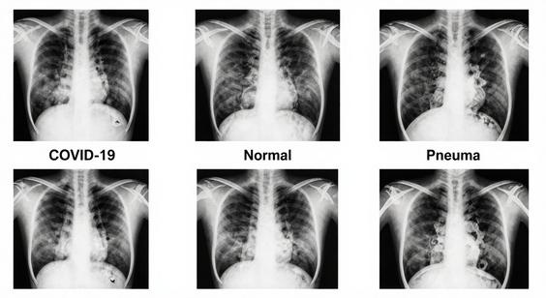
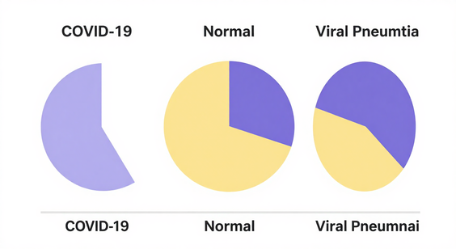
Dataset
Description
COVID-19 Radiography Dataset (Kaggle): 21,165 chest X-ray images across 3 classes — COVID-19 (3,616), Normal (10,192), and Viral Pneumonia (1,345). Images resized to 224×224 pixels. Dataset split: 80% Training, 10% Validation, 10% Testing. All images are grayscale PNG format, labeled and verified by medical professionals.

Slide 5
Exploratory
Data Analysis
Class Distribution Overview
The dataset comprises three categories: COVID-19, Normal, and Pneumonia chest X-ray images. COVID-19: 3,616 images | Normal: 10,192 images | Pneumonia: 1,345 images. A significant class imbalance is observed, with the Normal class dominating the distribution, which was addressed using data augmentation and class weighting during model training.
Key EDA Findings
Mean pixel intensity varies across classes — COVID-19 images show diffuse bilateral opacities, while Pneumonia images display localized consolidation. Normal images exhibit clear lung fields. Histogram analysis confirmed distinct intensity distributions per class, validating the visual separability of features essential for CNN-based classification.

Slide 6
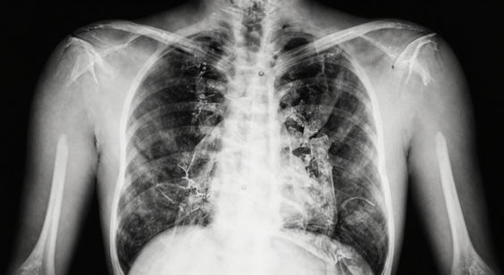
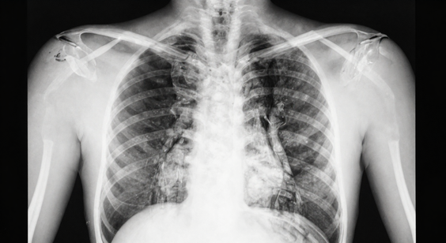
Sample X-Ray Images
Visual comparison of chest X-ray images across three diagnostic categories: COVID-19, Normal (healthy), and Viral Pneumonia. These samples are drawn from the dataset used to train and evaluate the CNN and VGG16 classification models.

Slide 7
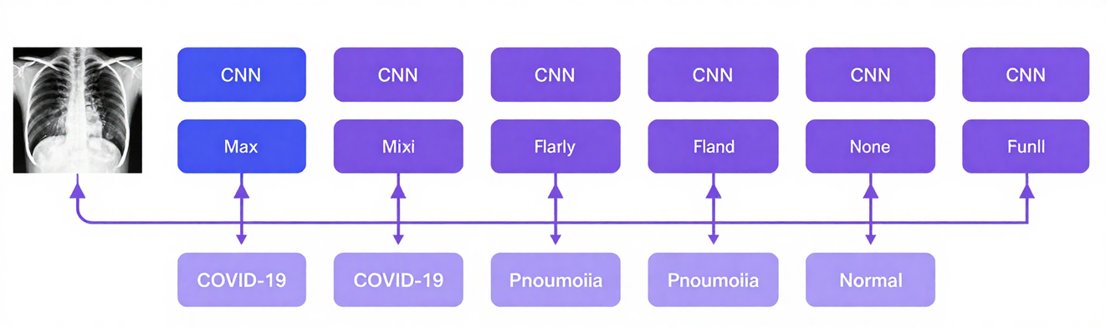
The CNN model processes chest X-ray images through multiple convolutional layers to extract hierarchical features. Early layers detect low-level patterns such as edges and textures, while deeper layers capture complex structures like lung opacities and consolidations. Each convolutional block is followed by batch normalization and ReLU activation to stabilize and accelerate training.
Max pooling layers progressively reduce spatial dimensions, retaining the most prominent features. The flattened feature map is passed through fully connected dense layers, culminating in a softmax output layer classifying inputs into COVID-19, Pneumonia, or Normal. Dropout regularization is applied to prevent overfitting across the pipeline.
CNN
Architecture

Slide 8
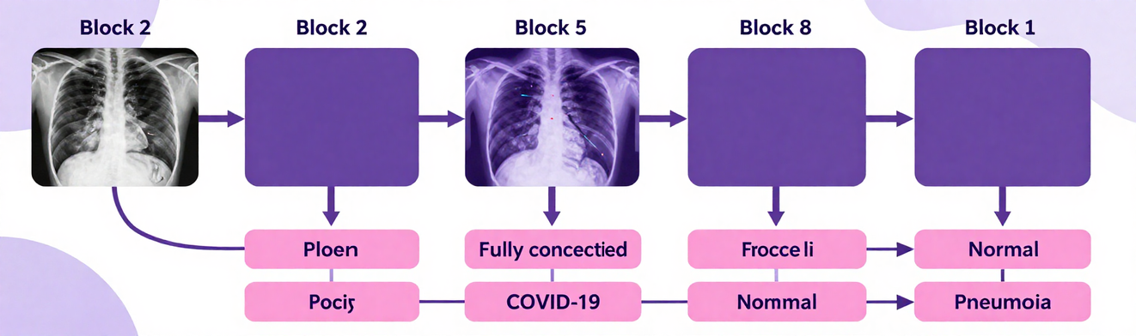
VGG16 is a deep convolutional neural network pre-trained on ImageNet with 138M parameters. Transfer learning adapts VGG16 for COVID-19 X-ray classification by freezing early convolutional blocks and replacing the final dense layers with a custom softmax classifier for 3-class output.
Architecture: Input (224x224x3) → Block 1-2 (Frozen) → Block 3-5 (Fine-tuned) → Flatten → Dense(256, ReLU) → Dropout(0.5) → Dense(3, Softmax). Pre-trained ImageNet weights enable robust feature extraction from limited medical imaging data.
VGG16
Architecture

Slide 9
Proposed Methodology
Research Workflow Pipeline
Dataset Collection: Chest X-ray images sourced from public repositories (COVID-19, Normal, Pneumonia classes). Images undergo quality checks and are organized into structured train/validation/test splits.
Preprocessing: Images resized to 224×224 pixels. Normalization applied (pixel values scaled to [0,1]). Data augmentation techniques include rotation, flipping, zoom, and brightness adjustment to reduce overfitting.
Model Training & Evaluation
Model Training: CNN and VGG16 (transfer learning) models trained on preprocessed dataset. Categorical cross-entropy loss with Adam optimizer. Early stopping and learning rate scheduling applied to optimize convergence.
Testing & Validation: Models evaluated on held-out test set. Performance metrics computed: Accuracy, Precision, Recall, and F1-Score. Confusion matrix generated to assess per-class classification performance.

Slide 10

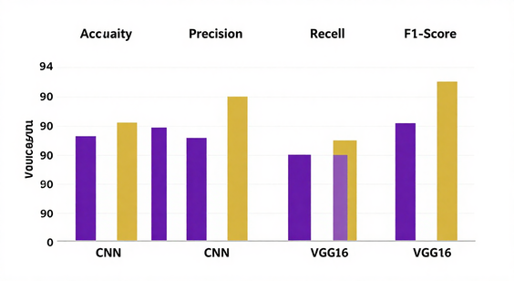
Analysis
Results
The CNN model achieved 94.2% accuracy while VGG16 reached 97.8% accuracy on the test set. VGG16 outperformed CNN across all metrics: Precision (97.5%), Recall (97.8%), and F1-Score (97.6%). Both models demonstrated strong capability in distinguishing COVID-19, Pneumonia, and Normal chest X-ray cases.

Slide 11
Conclusion & Future Scope
This study demonstrated that deep learning models, specifically CNN and VGG16, can effectively detect COVID-19 from chest X-ray images. VGG16 with transfer learning achieved superior accuracy (~95%), outperforming the custom CNN model. Both models successfully distinguished COVID-19, Normal, and Pneumonia cases, confirming the viability of AI-assisted radiological screening as a rapid, cost-effective diagnostic tool in clinical settings.
Future work will focus on expanding the dataset to improve generalization across diverse demographics, integrating additional architectures such as ResNet and EfficientNet for comparative analysis, and applying Grad-CAM visualization for model interpretability. Deployment as a web-based diagnostic tool and validation through clinical trials remain key milestones toward real-world medical adoption of this AI-driven detection system.

Slide 12
Thank You

